Slide 1

The Power of Education
This presentation explores the transformative power of education, emphasizing the importance of lifelong learning through emotional, ethical, and logical perspectives.
by Musawarali shah

Slide 2
Impact of Education
Better job opportunities and higher income
Staying employed and adapting to change
Education significantly enhances employment prospects, with data indicating that individuals with higher education levels tend to earn more over their lifetimes. Continuous learning equips individuals with the skills needed for various roles across different industries, increasing both employability and potential income.
In a rapidly evolving job market, lifelong learners are more likely to adapt to technological changes and stay employed. Studies suggest that continuous education can make one 20% more likely to retain job security as industries adapt to innovations such as artificial intelligence and automation.

Slide 3

Importance of new skills in a fast-evolving world
In today's fast-paced environment, acquiring new skills—such as coding, data analysis, or digital marketing—has become essential.
These skills not only enhance personal development but also make individuals more competitive in the job market.
Lifelong learning ensures that individuals can keep up with industry trends and technological advancements, allowing them to innovate and contribute effectively.

Slide 4

Joy of Learning
Thrill of mastering new skills
The exhilaration of mastering a new skill brings a sense of accomplishment and joy that can significantly enhance one's quality of life. Whether it's learning to play an instrument, speak a new language, or tackle a complex project, the process of discovery and overcoming challenges can be incredibly rewarding.
Boosting confidence and fulfillment
Continuously learning new skills not only boosts self-esteem but also fosters a sense of fulfillment. Individuals who engage in lifelong learning often report feeling more capable and confident in their abilities.

Slide 5


Personal stories of impactful learning
Personal stories of learning experiences can inspire audiences to pursue their own educational journeys.
Sharing anecdotes about the positive effects of learning—such as developing a new hobby, overcoming obstacles, or connecting with others—illustrates the profound influence that education can have on individual lives.

Slide 6

03 # Ethical Considerations
1
Equal access to education
Ensuring everyone has equal opportunities to learn is crucial for a just and equitable society. By removing barriers such as poverty or lack of infrastructure, we can create a world where everyone has the chance to reach their full potential.
2
Education for ethical growth
Education should equip individuals with the knowledge and critical thinking skills to make ethical decisions. By promoting empathy, compassion, and a sense of responsibility, we can foster a more ethical society where individuals are empowered to contribute to positive change.

Slide 7
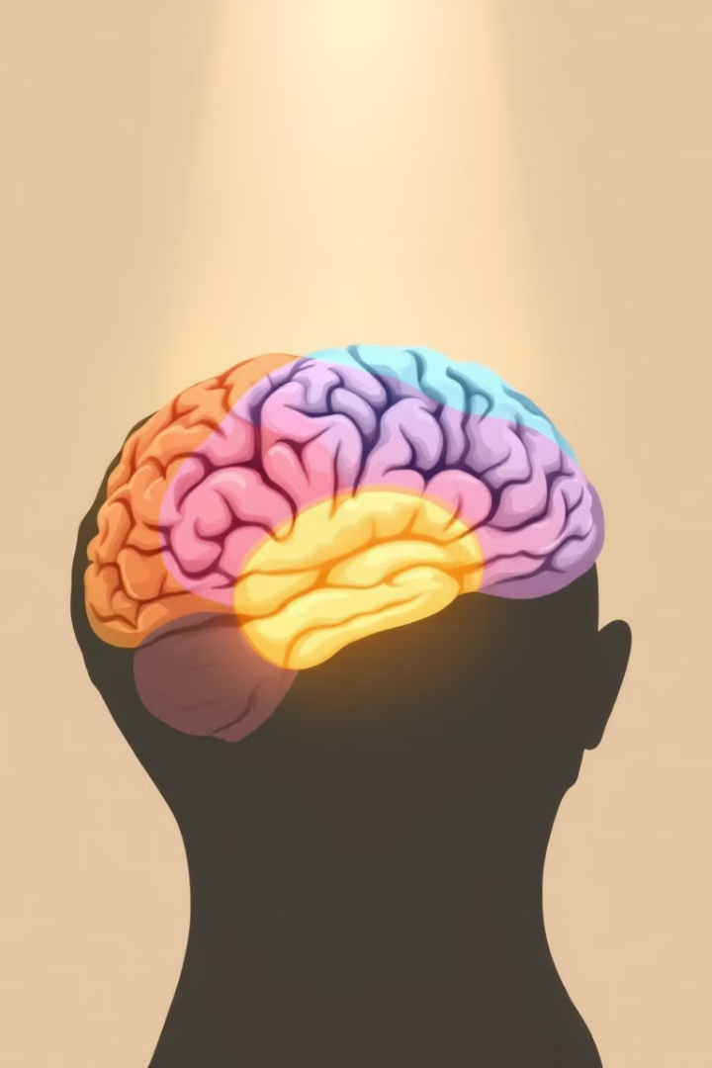


04 # Emotional Intelligence
Empathy and understanding
Learning enhances emotional intelligence by fostering empathy and understanding. Through diverse perspectives, we learn to connect with others, build stronger relationships, and navigate complex social situations with greater sensitivity.
Emotional self-regulation
Education can help us understand and regulate our emotions. By learning about different emotional states and developing coping mechanisms, we can manage our feelings more effectively, leading to improved well-being and healthier relationships.

Slide 8

05 # Logical Reasoning
Problem-solving
Education cultivates critical thinking and problem-solving skills. By learning how to analyze information, evaluate evidence, and generate solutions, we become more equipped to address challenges in our personal and professional lives.
Decision-making
Education helps us develop logical reasoning skills, leading to more informed decision-making. By considering various perspectives, gathering data, and weighing potential outcomes, we can make choices that align with our values and goals.

Slide 9



Key Takeaways
Personal Growth
2
Invest in your personal development for fulfillment and well-being.
Lifelong Learning
1
Embrace the continuous pursuit of knowledge and skills.
Positive Impact
Contribute to a better world through ethical decision-making.
3

Slide 10

Next Steps
Identify learning opportunities that align with your interests and goals. Seek out mentors, resources, and communities to support your lifelong learning journey.

